Slide 1

Senior Design Project: SodaShop
Justin Kleen, Austin Koenigs, Paul Litherland, Liam O’Malley, & Nic Witulski
5/6/25
University of Nebraska – Lincoln
Department of Electrical and Computer Engineering

Slide 2
Overview
An Outline of the Project
Background
Specifications
Explanation
Results
Conclusion
References

Slide 3

Background & Problem to be Solved
Cans of soda and other soda mixing machines do not allow for customer customization and control.
SodaShop allows for the ultimate customizability and control of soft drink creation bolstered by seamless automation.

Slide 4
Specifications
24 V operating voltage
6A rated current draw
4 peristaltic pumps
1 air pump
Rasberry pi 4B
Custom pcb with rp2040
2 relay boards with 4 relays each
7in touchscreen interface

Slide 5
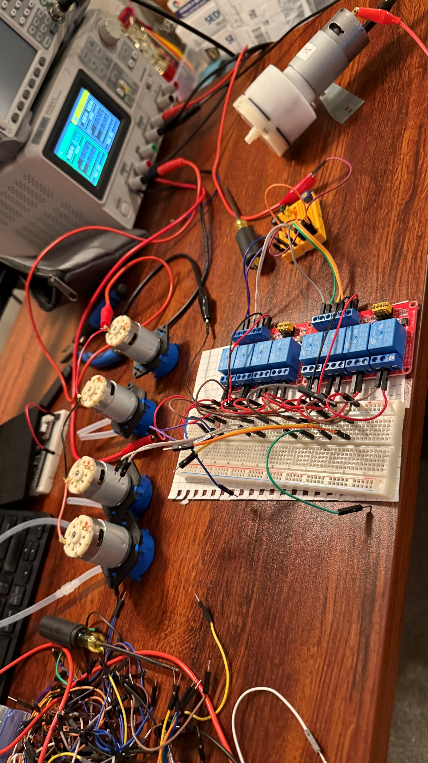
Explanation- Electronics
Relays:
Are controlled by custom pcb receiving signals from Raspberry Pi interface
Air Pump
24V
Peristaltic Pumps
24V
Challenges:
1 Relay per board was defective
Pumps were actually 12V
Air pump overcurrent
Needed to get larger power supply

Slide 6
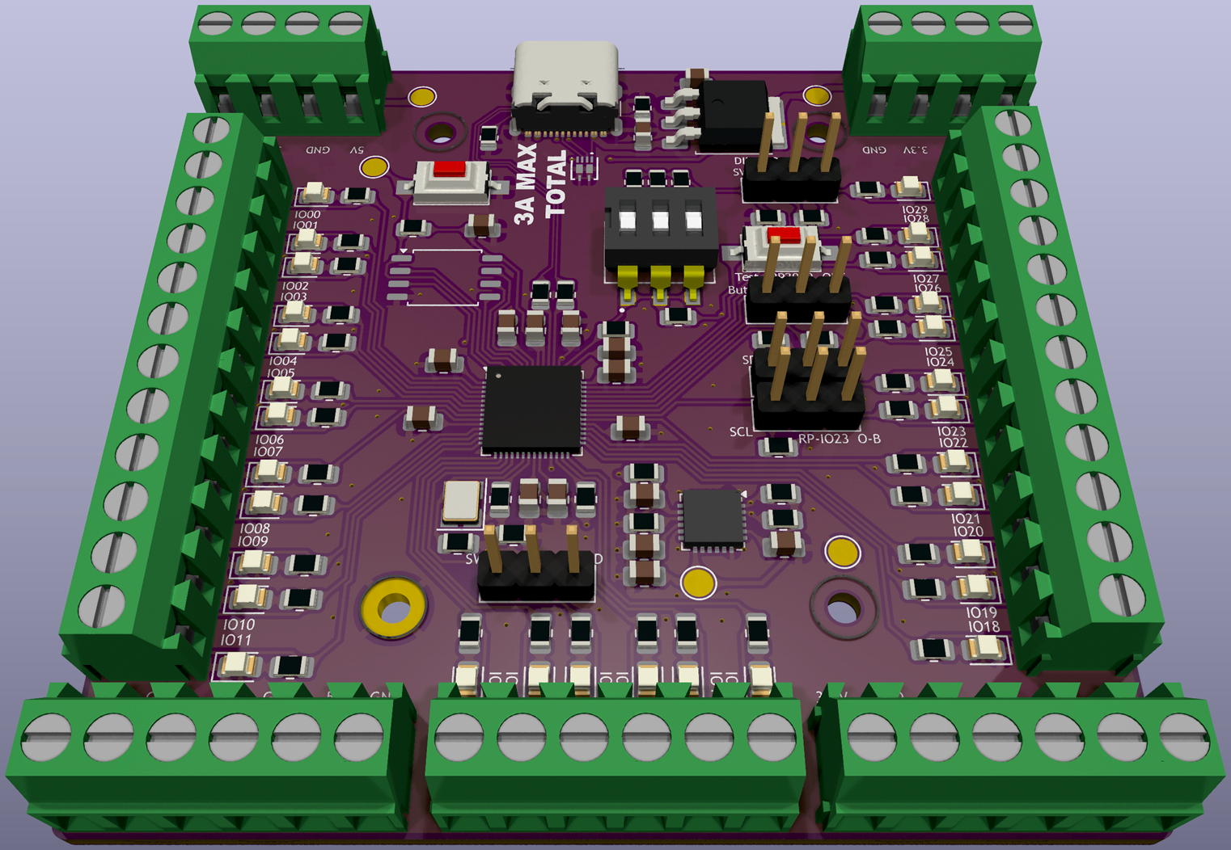

Explanation- Custom PCB
PCB:
RP2040 micro-processor
Screw gate terminals
LED’s for Debugging
Challenges
Missing trace, needed jumper wire

Slide 7
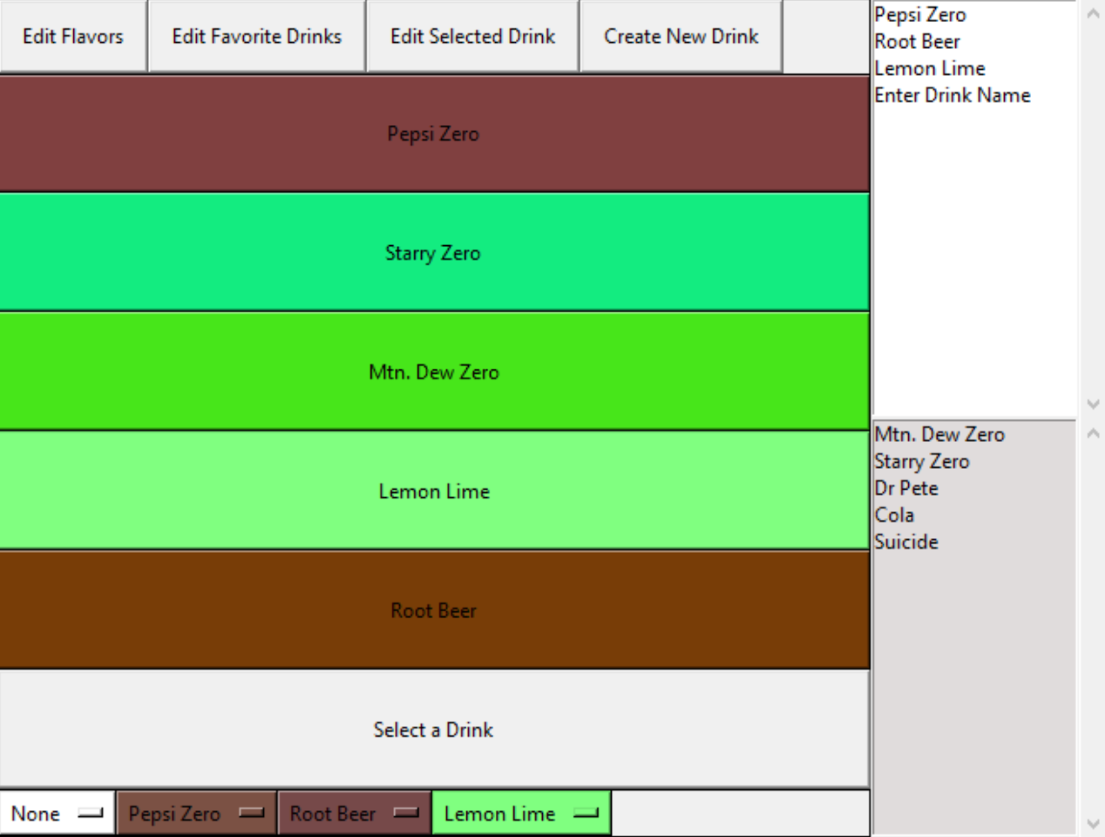
Explanation- Programming
UI Library:
GUIZero
Language
GUI: Python
Microcontroller: Micro-python
GitHub
Challenges
Bug with distribution of drink slots and what was dispensed

Slide 8
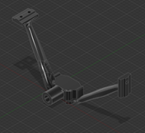
Explanation- Frame and 3D Printing
Frame
20mm aluminum channeling cut to 18”
3D printed brackets to connect them in the corners
Electronic mounts:
Designed for: relays, grounding strip, power supply, touch screen, nozzle, nozzle holder, corner brackets, T-nuts, plexiglass holder, wire manager, air pump, peristaltic pumps, and drip tray.
Challenges
3D printer errors, designing perfect fit parts, plastic breaking

Slide 9
Cost Breakdown
Mini power strip: $4.98
Raspberry Pi 4 (2GB): $58.91
Silicone Tubing, 1/4" ID x 3/8" OD High Temp Food Grade, 10 Feet: $11.99
Air Pump: $18.69
4 Channel 24V Relay Module w/ Optocoupler High/Low Trigger: $12.99 (x2)
Assortment of 2.8mm, 4.8mm, and 6.3mm Female Spade Crimp Terminal with Insulating Sleeve and Wire,25cm: $9.99
24V 400W Transformer PSU, AC/DC Converter, 100~265VAC Input: $24.99
Silicone Tubing, 3mm ID x 5mm OD High Temp Food Grade, 3m: $7.99
24V DC Peristaltic Liquid Dosing Pump, 90mL/min: $12.70 (x4)
Custom designed PCB from OshPark, 2 oz copper, 0.8mm thickness: $44.00
Total: $491.53

Slide 10
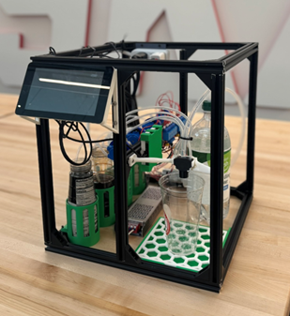
Summary
Functional GUI interface with back end code
Sturdy aluminum frame
Plethora of custom 3D printed mounts
Functional syrup and water pumping
Overall successful projects!

Slide 11

Conclusion
Thank you!!
Questions?

Slide 12
References
UL Solutions, “IEC 62368-1 Testing and Certification,” UL, [Online]. Available: https://www.ul.com/services/iec-62368-1-testing-certification. [Accessed: May 6, 2025].
UL Solutions, “Explore the Benefits of Industrial Control Panel Certification,” UL, [Online]. Available: https://www.ul.com/explore-benefits-industrial-control-panel-certification. [Accessed: May 6, 2025].
UL Solutions, “Attachment Plug and Receptacle Safety Evaluations,” UL, https://www.ul.com/services/attachment-plug-and-receptacle-safety-evaluations (accessed May 6, 2025).
NSF International, NSF/ANSI 18-2022 – Manual Food and Beverage Dispensing Equipment. Ann Arbor, MI: NSF International, 2022. [Online]. Available: https://webstore.ansi.org/standards/nsf/nsfansi182022. [Accessed: May 6, 2025].
European Commission, “Electromagnetic Compatibility (EMC) Directive,” Single Market Economy, https://single-market-economy.ec.europa.eu/sectors/electrical-and-electronic-engineering-industries-eei/electromagnetic-compatibility-emc-directive_en (accessed May 6, 2025).
M. O’Hanlon and L. Sach, “guizero: A Python 3 library for creating simple GUIs,” guizero Documentation, https://lawsie.github.io/guizero/ (accessed May 6, 2025).
u/Neurodoc, “Pumping a carbonated liquid,” Reddit, r/AskEngineers, Jun. 28, 2014. [Online]. Available: https://www.reddit.com/r/AskEngineers/comments/290rbu/pumping_a_carbonated_liquid/

